Slide 1
Scientific writing
Arash Khojasteh, DMD, OMFS
Notes:
It is my honor to be the moderator of the first English journal club of MOHME
Actually this can trigger a surge toward english writing , and I really believe that the only way to survive is to publish our data
Why we publish our data?
To get funding
To be promoted
To get a new job
To keep your job
To get

Slide 2
“There is no way to get experience except through experience.”
Notes:
There is no way to get experience except through experience

Slide 3
What is written without effort is in general read without pleasure
Samuel Johnson (1709-1784)

Slide 4
WHY SCIENTISTS PUBLISH
Publications are:
Golden eggs of an academic life
Disseminate the knowledge
Encourage discussion within the professional
community
Fundamental component of an academic career
Developing the scholarly base
Sutherland 2003

Slide 5
“Scientists are rated by what they finish, not by what they attempt”

Slide 6
Way of communications
Conferences
Evening news
Scientific Writing
Kenneth Rothman
Notes:
Behnam

Slide 7
Reasons to publish
It is unethical to conduct a study and not report a findings
You want to progress scientific through or improve health outcomes
You want to give credibility to your research team
You will improve your chance of promotion
You are more likely to obtain research grant

Slide 8
WHY SCIENTISTS PUBLISH
No publication…………. No project
No publication………….No funding
No publication…………No promotion
No publication …….Scientific & academic death
Edwin & Vanora, 2002; Jonathan, 2004

Slide 9
Why Don’t We Write?
Not enough time
Nothing to write about
No one to write with
No secretarial support
No knowledge of how to begin
No mentor for guidance
No self-confidence
Dislike of writing
Notes:
You can see here the causes that stop us to writing
Actually I believe journal club can overwhelm ( at least ) the 2 last factor

Slide 10
HISTORICAL BACKGROUND
1665, first scientific paper
Original manuscript
Scientific letter
Book chapter
Experimental report (19th century)
IMRAD method (1960’s)

Slide 11
HOW TO BECOME A SUCCESSFUL WRITER
You can write an article as long as you stick to few rules.

Slide 12
Authorship

Slide 13
AUTHORSHIP
Decide the author ship before the start of
research project
Authors should include those who have made a
significant intellectual contribution

Slide 14
AUTHORSHIP ORDER
The first author: Primarily responsible for collecting and analyzing data and writing the manuscript
The middle authors: Listed according to their order of importance to the study
The last author: Established investigator, assumes the overall responsibility for the study

Slide 15
Authorship
Vancouver guideline
Guidelines on authorshop, International committee of Medical Journal Editors,
Reprinted by kind permission of the Editor of the British Medical Journal of Sept
14, 1985. J Clin Pathol 39: 110, 1986

Slide 16
Role of Statistician
A statistician is a person who likes to prove you wrong 5% of the time

Slide 17
Checklist for assessing statistical contribution to a study
contribution | Points if Involved
Study Design
protocol development | 4
data analysis and management | 2
overall review of grant application | 1
Implementation
regular participation | 4
data collection | 2
Advising only on specific question | 1
Analysis
planning and directing the analyses | 4
preparing writing material | 2
doing the data analyses | 1

Slide 18
Statistician co author ship
Point 5 or fewer do not warrant authorship
Point 6-7 indicate possible authorship

Slide 19
Credit point system for deciding authorship
contribution | Points if Involved
Initiation phase | 3
Idea
review
Grant application
Pilot Phase | 2
Development of instrument plus pilot study
Execution Phase | 1
management and key worker
Analysis Phase | 4
Analysis design and paper design

Slide 20
Journal Selection
Impact Factor

Slide 21
SELECTION OF THE JOURNAL
Scientists should select a journal before putting the pen on a paper. The selection of journal should be based on:
Manuscript title
Novelty of the research work
Types of the readers
Prestige of the journal [Impact factor]

Slide 22
SELECTION OF THE JOURNAL

Slide 23
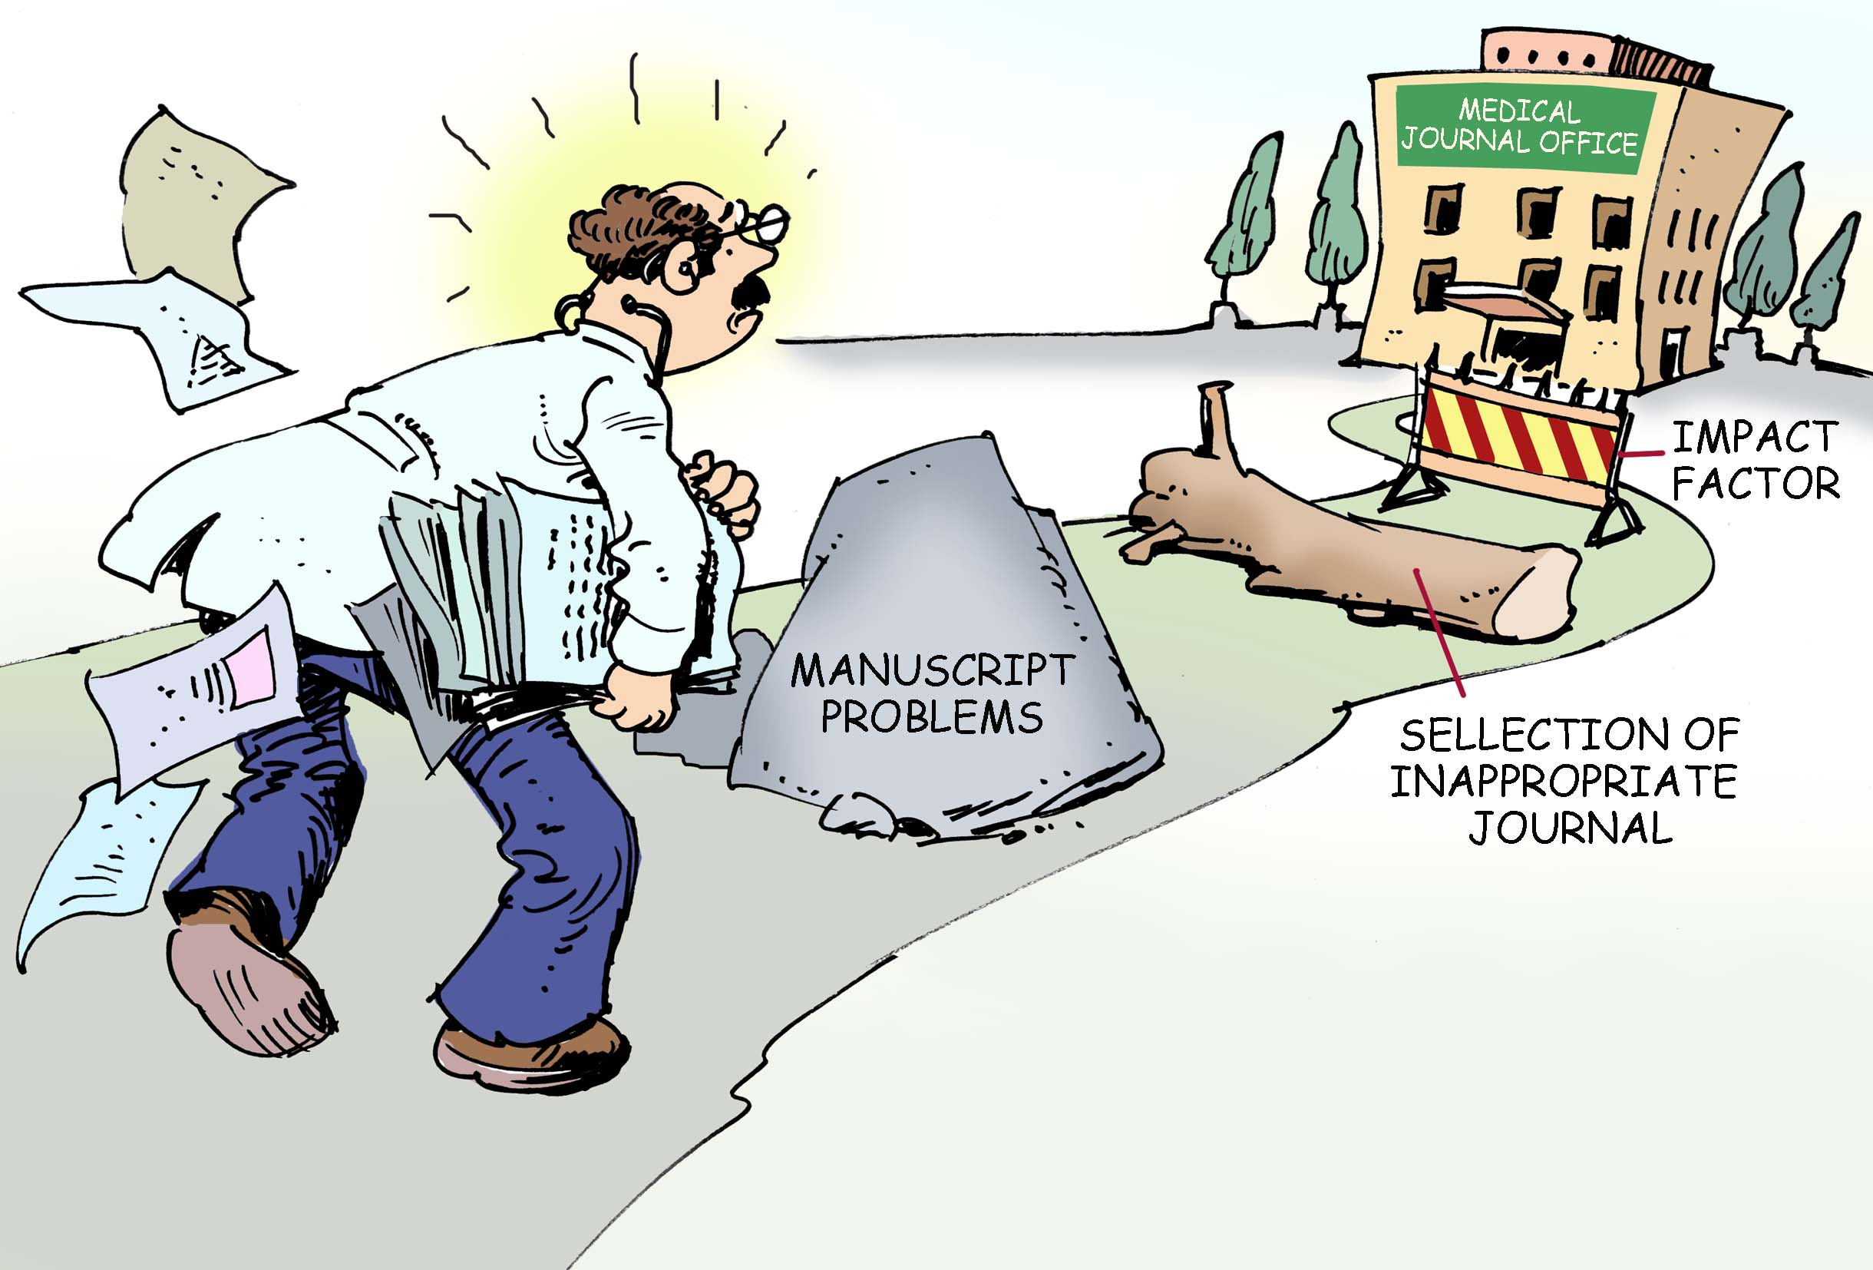
SCIENTISTS SHOULD LOOK
Match your paper with the personality and scope of the journal
Match your subject with the journal target audience
Consider the journal impact factor
Weigh up the journal prestige
Have realistic expectation
Be roboust and if rejected select another journal

Slide 24
IMPACT FACTOR
Impact factor may provide quantitative tools for:
Evaluating
Ranking
Categorizing
Comparing journals
[ISI 2001; Edwin & Vanor, 2002 ]

Slide 25
IMPACT FACTOR
Some scientists believe that impact factor:
Is misunderstood & not a perfect tool to decide the prestige and quality of the journal
Does not measure the quality of publication but mostly the quantity
Is more of a popularity gauge than quality
Peng et al., 2005; Shidham et al., 2006

Slide 26
IMPACT FACTOR
Impact Factor is not a perfect tool to measure the quality of articles but there is nothing better.
It has the advantage of already being in existence therefore, a good technique for scientific evaluation
Hoeffel. Allergy, 1998

Slide 27
Getting Started
Writing the paper

Slide 28
Things to consider before writing
1. Time to write the paper?
- has a significant advancement been made?
- is the hypothesis straightforward?
- did the experiments test the hypothesis?
- are the controls appropriate and sufficient?
- can you describe the study in 1 or 2 minutes?
- can the key message be written in 1 or 2 sentences?
“Generally keep it short and to the point .
It is not a novel you are writing . If you get stuck, take a break ”
Anthony David

Slide 29
Things to consider before writing
1. Time to write the paper?
- has a significant advancement been made?
- is the hypothesis straightforward?
- did the experiments test the hypothesis?
- are the controls appropriate and sufficient?
- can you describe the study in 1 or 2 minutes?
- can the key message be written in 1 or 2 sentences?
“Those who have the most to say usually say it with the fewest words”

Slide 30
Planning
Before beginning

Slide 31
Before Beginning
Begin with the plan in mind
You must focus on the potential audience for whom you are writing for.

Slide 32
THINKING – KNOWLEDGE -WRITING
Thinking is essential to knowledge and knowledge is essential to thinking. Therefore, attention should be given for thinking skills while writing a manuscript
Scientific background
Reasoning
Creative thinking
[Nickerson, 1985; Nibroj, 2005; Schon et al., 2006]

Slide 33
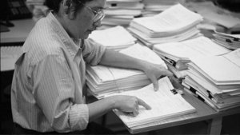
MANUSCRIPT WRITING
STEPS TO FOLLOW
THINK
WRITE
STOP
THINK
AGAIN
REVIEW

Slide 34
Planning Stage
Set Framework for Document
Grotty First Draft
Page Size
Heading
Put Ideas on paper
Plan topic Sentences
Construct Tables and Figures
Identify Questions
To be answered

Slide 35
Presentable Second Draft
Good Third Draft
Excellent Fourth Draft
Final Document
Use Journal
Checklist and
instruction
Circulate to peer
And Coauthors
Polish up
Revisit
check list
Submit to Journal

Slide 36
Manuscript Framework
Set Framework for Document

Slide 37
Manuscript Sequence
Title page
Abstract
Key words
Text
Acknowledgements
References
Tables
Legends to figures

Slide 38
Text: IMRAD format
Introduction
Methods
Results And
Discussion
What problem was studied? What others and you did?
How do you did it?
What you found out?
What your findings mean?... and future plans

Slide 39
Writing Order
Method
Results
Introduction
Discussion
Abstract
Title
http://web.archive.org/web/20011127041109/www.hms.harvard.edu/fdd/comm/index.html

Slide 40
Examples of some uniform requirement
Use double spacing throughout
Page should have 25 mm margin
Maintain the sequence Title page, abstract, key words, text , acknowledgement, references, tables, legend to figures
IMRAD for the text
Begin each section on a new page
Each table should be on a new page
The figures are 5*7 or 6*4 inches
Keep and exact copy of everything submitted

Slide 41
A basic rule is to read the instruction to authors.

Slide 42
Standardized reporting guidelines
The consolidated standards of reporting trials (CONSORT) for clinical trials
Meta Alanysis of observational study in epidemiology (MOOSE)

Slide 43
Title

Slide 44
RIGHT TITLE
Title is the first part of the journal a reader looks at
A good title is like an honest advertisement, the reader will be attracted to the manuscript
A poor title is like a quarantine sign, the reader will approach only close enough to read the sign and then hurry away
[Peter Morgan, 1986]

Slide 45
TITLE SHOULD HAVE
Good taste
Fascinate the reader
Same tone as the essay
[Packer et al., 1989; Greenberg, 1992]

Slide 46
TITLE SHOULD BE
Specific enough to describe the contents of the paper
Not so technical that only specialists understand
Appropriate for the targeted audience
Less than 12 words & 100 characters
Never contain abbreviations

Slide 47
Title
Fewest words to describe the content
Avoid
A study of
Investigations of
Observations on
Include
A particular species
A region

Slide 48
Title
Statement of the question or problem
How smoking affects students’ grade?
How air quality in Tehran affects public health?
Specific enough to describe the contents or subject matter but not too technical
Effect of smoking on academic performance
Effect of air quality in Tehran on public health
www.biochem.arizona.edu/marc/sci-writing.pdf

Slide 49
Abstract

Slide 50
Abstract
Short summary of the paper
Purpose
Methods
Results
Conclusions
Don't use abbreviations or citations
http://www.columbia.edu/cu/biology/ug/research/paper.html
Notes:
“search word”: arsenic, trace element, heavy metal, heavy element.

Slide 51
Abstract
A shortened version of a paper
Most read section of a paper
Contain all information necessary for the reader to determine:
The objectives of the study-Introduction;
How the study was done-Methods;
What results were obtained-Results & Discussions;
The significance of the results-Conclusion.
Write the abstract last
http://classweb.gmu.edu/biologyresources/ writingguide/scientificpaper.htm

Slide 52
COMMON PROBLEMS IN ABSTRACT
Too long
Too much detail
Too short
Failure to include important information

Slide 53
Introduction

Slide 54
Introduction
Is the most difficult part of the manuscript
Should be short and arresting
Tell the reader why you undertook the study
http://www.columbia.edu/cu/biology/ug/research/paper.html

Slide 55
“you should never put a text book knowledge in your introduction.”
Notes:
There is no way to get experience except through experience

Slide 56
Introduction
Introduction
Discuss how the data will add knowledge to the field
What specific questions you tried to address
Why is this study of scientific interest and what is your objective
The last sentences should be a statement of objectives and a statement of hypotheses
owl.english.purdue.edu/owl/resource/559/03/
web.archive.org/web/20011127041109/www.hms.harvard.edu/fdd/comm/index.html

Slide 57
“It is important to convince the journal editor that your study extends knowledge rather than merely confirm what we are know .”
Notes:
There is no way to get experience except through experience

Slide 58
Methods

Slide 59
Methods
The most important part of your paper
It depends to the type of the study

Slide 60
METHODS
Write as soon as methods are mature
Make sure all statistic is clear
Equations are often necessary to describe methods
Arguments can be encapsulated neatly
Don’t force the reader to understand something
that’s not crucial to the paper
No excuse for statistical errors

Slide 61
GENERAL PRINCIPLES
Study design / types/ consent
Study protocol / Inclusion / exclusion criteria
Reference to standard procedures / techniques
Innovative techniques / Equipment / Material used
Data collection / analysis / statistical methods
Strength / limitations

Slide 62
Some Types of Manuscripts
Review articles
Case reports
Editorials
Letters to the editor
Monographs
Descriptive practice reports
Original research
Poster presentations
Book chapters
Books

Slide 63
Results

Slide 64
Results
Focus on
Describe the results in sufficient details to establish their validity
Identify the novel aspects of the results
What is new and what makes it non-obvious;
Identify the significance of the results
Implicated improvements and impact.
Things to avoid
Do not include the same data in a table and a figure
Too much motivational material
Describe obvious results
Describe unnecessary details
http://www.cs.columbia.edu/~hgs/etc/writing-style.html

Slide 65
General rules for figures/tables
Must have a caption
Using a capitalized name
Figure 1. Ethylene glycol process flow sheet
Should stand alone as much as possible
Compare multiple plots, put them on one graph
If the result is too cluttered, use different graphs
Keep the scales consistent to compare
Use different symbols and line types to distinguish multiple plots on the same graph
Include error bars
http://www.ent.ohiou.edu/~valy/techwrite.html

Slide 66
General rules for number
Rule | Correct expression
Number less than 10 are words | in the study group , eight ….
Numbers 10 or more are numbers | There were 120 participant
Words number not begin a sentence | Twenty percent of the participant had ….
Do not use space between number and the percent sign | In total 35% of participant….
Use one space between a number and it is unit | The mean height of group is 170 cm
Report percentage to only one decimal if the sample size is larger than 100 | In our sample 10.4% had diabetes
Do not use percentage if the sample size is less than 20 | In our sample of 18 children , two had diabetes
For the range use to or a comma but not “_” | 156 to 168 or 154, 168

Slide 67
TABLES
Make sure tables are properly captioned
Use tables if data are better tabulated than displayed as a figure

Slide 68
Discussion
Say what your findings mean , not what you would like them to mean

Slide 69
Discussion
How do your findings compare
To the findings of others
To expectations based on previous work?
Are there any theoretical/practical implications of your work?
http://www.biochem.arizona.edu/marc/Sci-Writing.pdf

Slide 70
Discussion: first paragraph
The result from this study showed that…..
The purpose of this study was to…
Our result indicate that…

Slide 71
Discussion: second Paragraph
The strength and limitation of your study

Slide 72
Middle paragraphs: n-1
Explain your results in the light of other studies

Slide 73
Final Paragraph
In summary…..

Slide 74
Never finish discussion with
Further studies are needed….
We are now investigating whether…
Notes:
The aim of the paer is to tell what you have found

Slide 75
Conclusion

Slide 76
CONCLUDING PARAGRAPH OF
THE MANUSCRIPT
Functions of concluding paragraphs are:
To make last effort to convince the reader
To suggest larger implications that the evidence has been presented
To provide a satisfying sense of closure

Slide 77
GENERAL SUGGESTIONS
Strictly follow the format of the journal
Incomplete style irritates the reviewers & editors
Wrong reference style suggests that another journal previously rejected the manuscript
Always use the Harvard system (Smith, 2005) for references and convert to the style of selected journal in the final draft

Slide 78
AVOID REPETITION
Do not……
Disclose your results in the introduction
Repeat the introduction in discussion
Repeat the results in tables and figures

Slide 79
Writing style

Slide 80
Writing the manuscript
The hardest part is getting started.

Slide 81
Why can’t I get started writing?
The easiest thing to do on earth is not write. (William Goldman)
"One of the most difficult things is the first paragraph. I have spent many months on a first paragraph, and once I get it, the rest just comes out very easily." (Gabriel Garcia Marquez)
"The secret of getting ahead is getting started. The secret of getting started is breaking your complex overwhelming tasks into small manageable tasks, and then starting on the first one." (Mark Twain)
Notes:
Here I want to mention …..
Here we can see some beautiful sentence
When we start to write and break the fear of writing the faith of finishing the project help us to progress and write more and more

Slide 82
Use of tense
Verb tense
All formal technical writing uses the past tense
Describing methods and results
Use present tense for things that are true when the author writes about them and will still be true in the future when the text is read
Published information or accepted facts
Background information presented in the Introduction
Discuss your results and conclusions
Use of past tense
Abstract
Materials and Methods
Results sections
Introduction and Discussion sections when referring to your experiment
http://www.rbs0.com/tw.htm

Slide 83
Words and expressions to avoid
Jargon Preferred use
a considerable amount of much
on account of because
a number of several
Referred to as called
In a number of cases some
Has the capacity to can
It is clear that clearly
It is apparent that apparently
Employ use
Fabricate make
Day, RA. “How to write and publish a scientific paper,” 5th edition, Oryx Press, 1998.

Slide 84
Avoiding Verbosity
INSTEAD OF:
At this time
At the conclusion of
In only a small number of cases
In light of the fact that
In the event that
In the not too distant future
Has the capability to
In close proximity to
CONSIDER:
Now
After
Rarely
Because
If
Soon
Can
Near

Slide 85
Submission

Slide 86
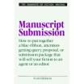
MANUSCRIPT SUBMISSION
Online / Email / Postal services
Polite covering letter
Appreciate the prestige of the journal

Slide 87
Submission
Read instructions carefully
Fill out all necessary forms
Copyright transfer
Conflict of interest
Write cover letter (suggest reviewers)
Confirm receipt after 6 weeks

Slide 88
EDITORIAL OFFICE
Submission.
Ed. review
Peer Rev.
Reply. Ed off.
Revise Manus.
Re Sub.

Slide 89
PEER REVIEW
A ONE TIME PASS THAT
Helps & improves the poor papers
Filters out terrible papers
But the quality is uneven & who says that referees knows best…..
Jonathan, 2004

Slide 90
POWER OF THE PEER REVIEW
REVIEWER 1
I found this manuscript extremely muddled with many deficits…….
REVIEWER 2
The manuscript is written in clear style with novel ideas and would be understood by any reader…….
Jonathan, 2004

Slide 91
PROBLEM WITH THE PEER REVIEW
Slow
Expensive
Lottery
Ineffective
Biased
Easily abused
Cant detect the fraud

Slide 92
PROBLEM WITH THE PEER REVIEW
Peer review is bias & favoring authors by:
Geographic location
English-speaking countries
Prestigious academic institutions
[Ross et al., JAMA, 2006]

Slide 93
Revising the Manuscript

Slide 94
RECEIVING THE REVIEWS
Re-read the critique
Try to understand what the reviewers are really saying
If reviewer didn’t understand what you were trying to say, discuss the issues with colleagues
Look for clues in the editor’s covering letter
Consider which issues are really critical
Don’t hesitate to stand firm if that is the right thing to do

Slide 95
RECEIVING THE REVIEWS
Make a numbered list of points in each critique, and start to draft your response
Responses should be thoughtful and clear
Omit the emotion
Under each point, detail exactly what changes are made in the manuscript and quote any text that has been added or altered

Slide 96
Process of Research
Completion of research
Preparation of manuscript
Submission of manuscript
Assignment and review
Decision
Rejection
Revision
Resubmission
Re-review
Acceptance
Rejection
Publication

Slide 97
Tips

Slide 98
Tips
Know the journal, its editors, and why you submitted the paper there
Pay close attention to spelling, grammar, and punctuation
Make sure references are comprehensive and accurate
Avoid careless mistakes
Read and conform to “Instructions for Authors”

Slide 99
“The Seven Deadly Sins”
Data manipulation, falsification
Duplicate manuscripts
Redundant publication
Plagiarism
Author conflicts of interest
Animal use concerns
Humans use concerns
Notes:
Balancing act between publishing high quality articles in outstanding journals and getting the numbers.
Grant reviewers look at both… how many papers and in what journals.

Slide 100
Revise, revise and revise
All authors should participate
Review order of data presentation
Polish the writing style
Double check references
Look for typos
Double check spelling

Slide 101
“There is no way to get experience except through experience.”

